Slide 1






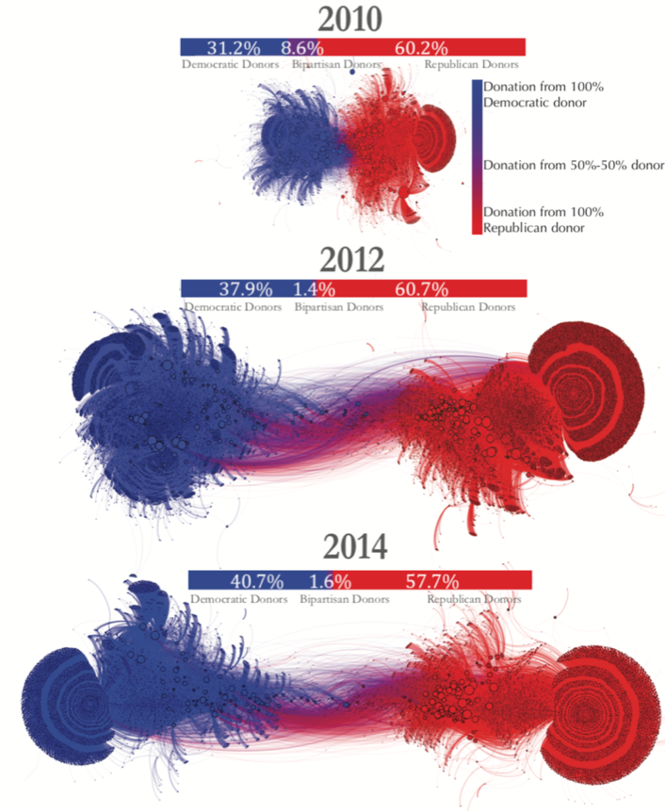
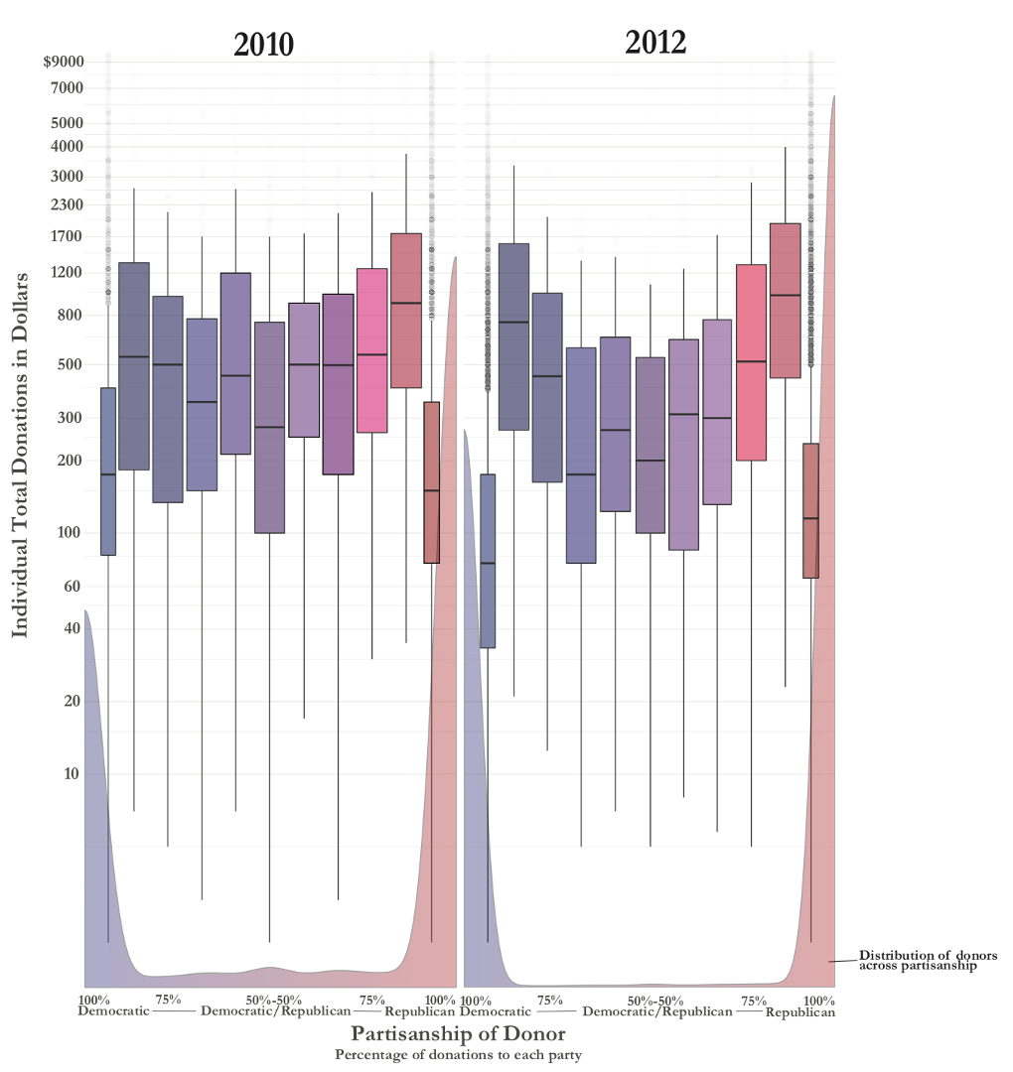
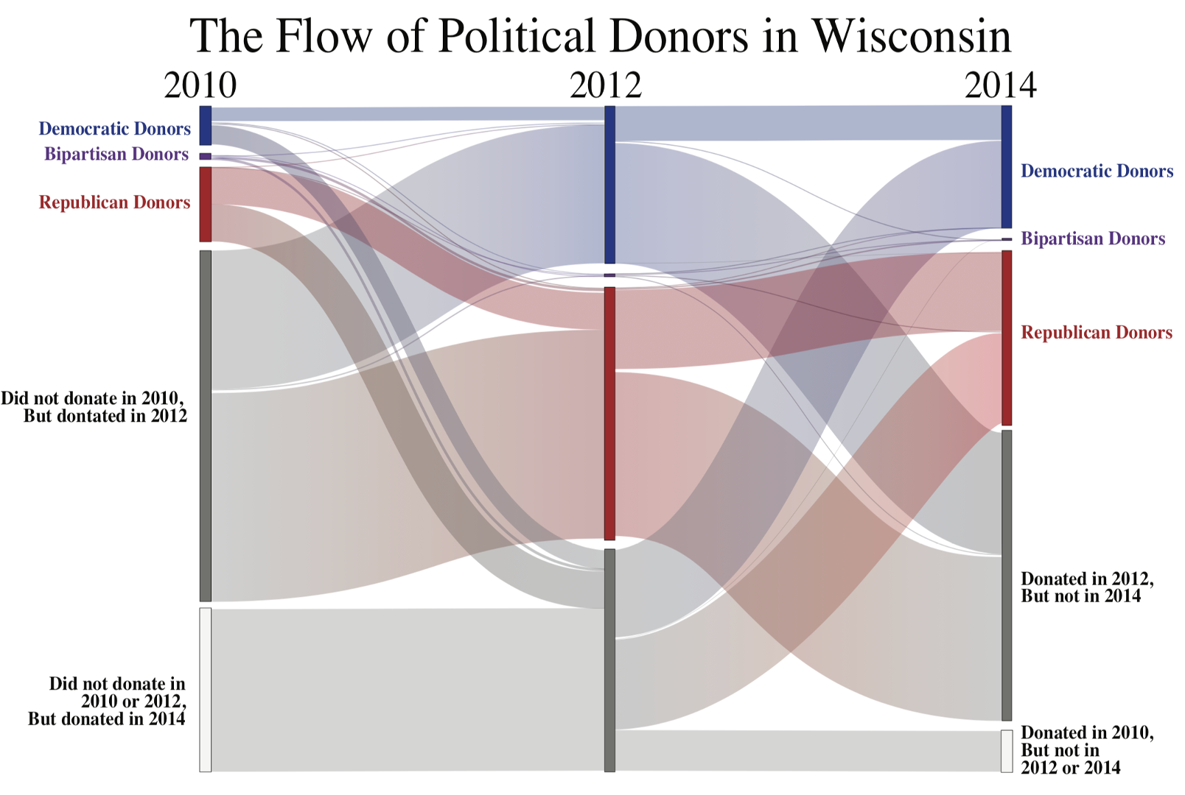
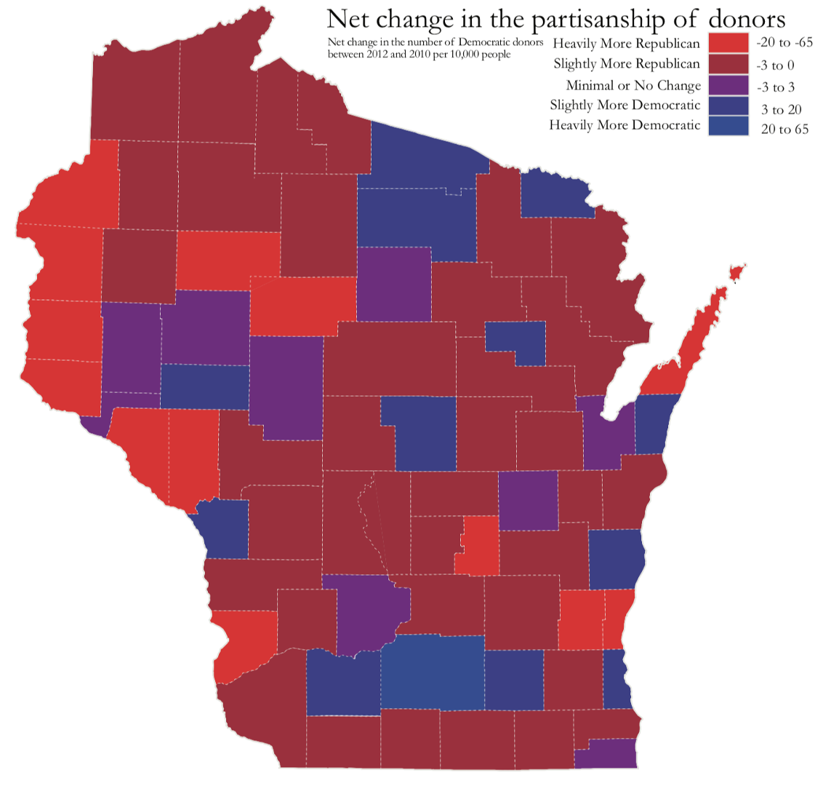
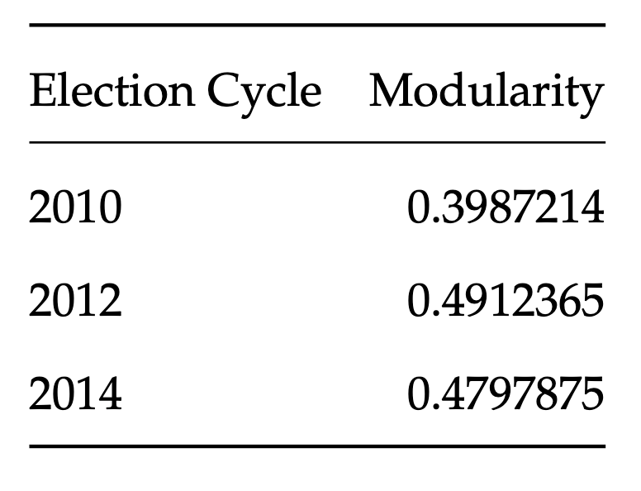
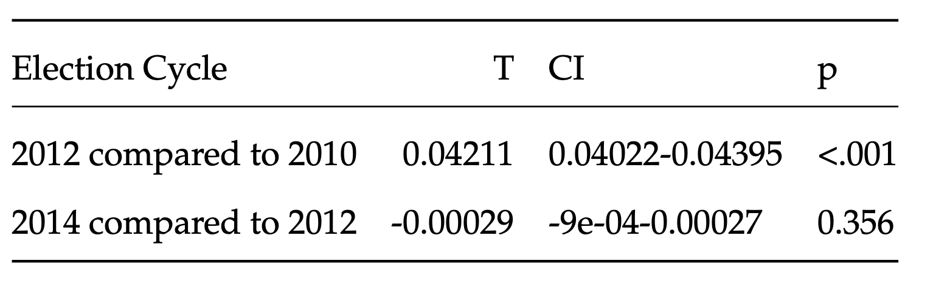
The Polarization of Political Donors
Ross Dahlke
@ross_dahlke
github.com/rossdahlke
Stanford University
rdahlke@stanford.edu
Abstract
American politics has recently been defined by unprecedented levels of partisan polarization. Given the concurrent rise of the amount of money in politics, many have suggested a connection between money in politics and polarization, but it remains unclear if donors have become more polarized. Using political donation data from the Wisconsin Campaign Finance Information System (CFIS) and using the network science measure of modularity, this paper shows that political donor networks have polarized. This polarization is driven by new donors, large donors, and donors from geographic areas that are strong electorally for either party.
Data
1.5m donations to Wisconsin gubernatorial and state legislative campaigns in the 2010, 2012, and 2014 election cycles were used to build networks
Donors and campaigns as nodes
Donations as edges
Two measures of polarization
Modularity:
Difference-in-means:
Acknowledgements
University of Wisconsin-Madison: Prof. Michael Wagner
Stanford University: Prof. Jeff Hancock; Prof. Jen Pan; Ryan Moore
1.
3.
2.
4.

